Slide 1
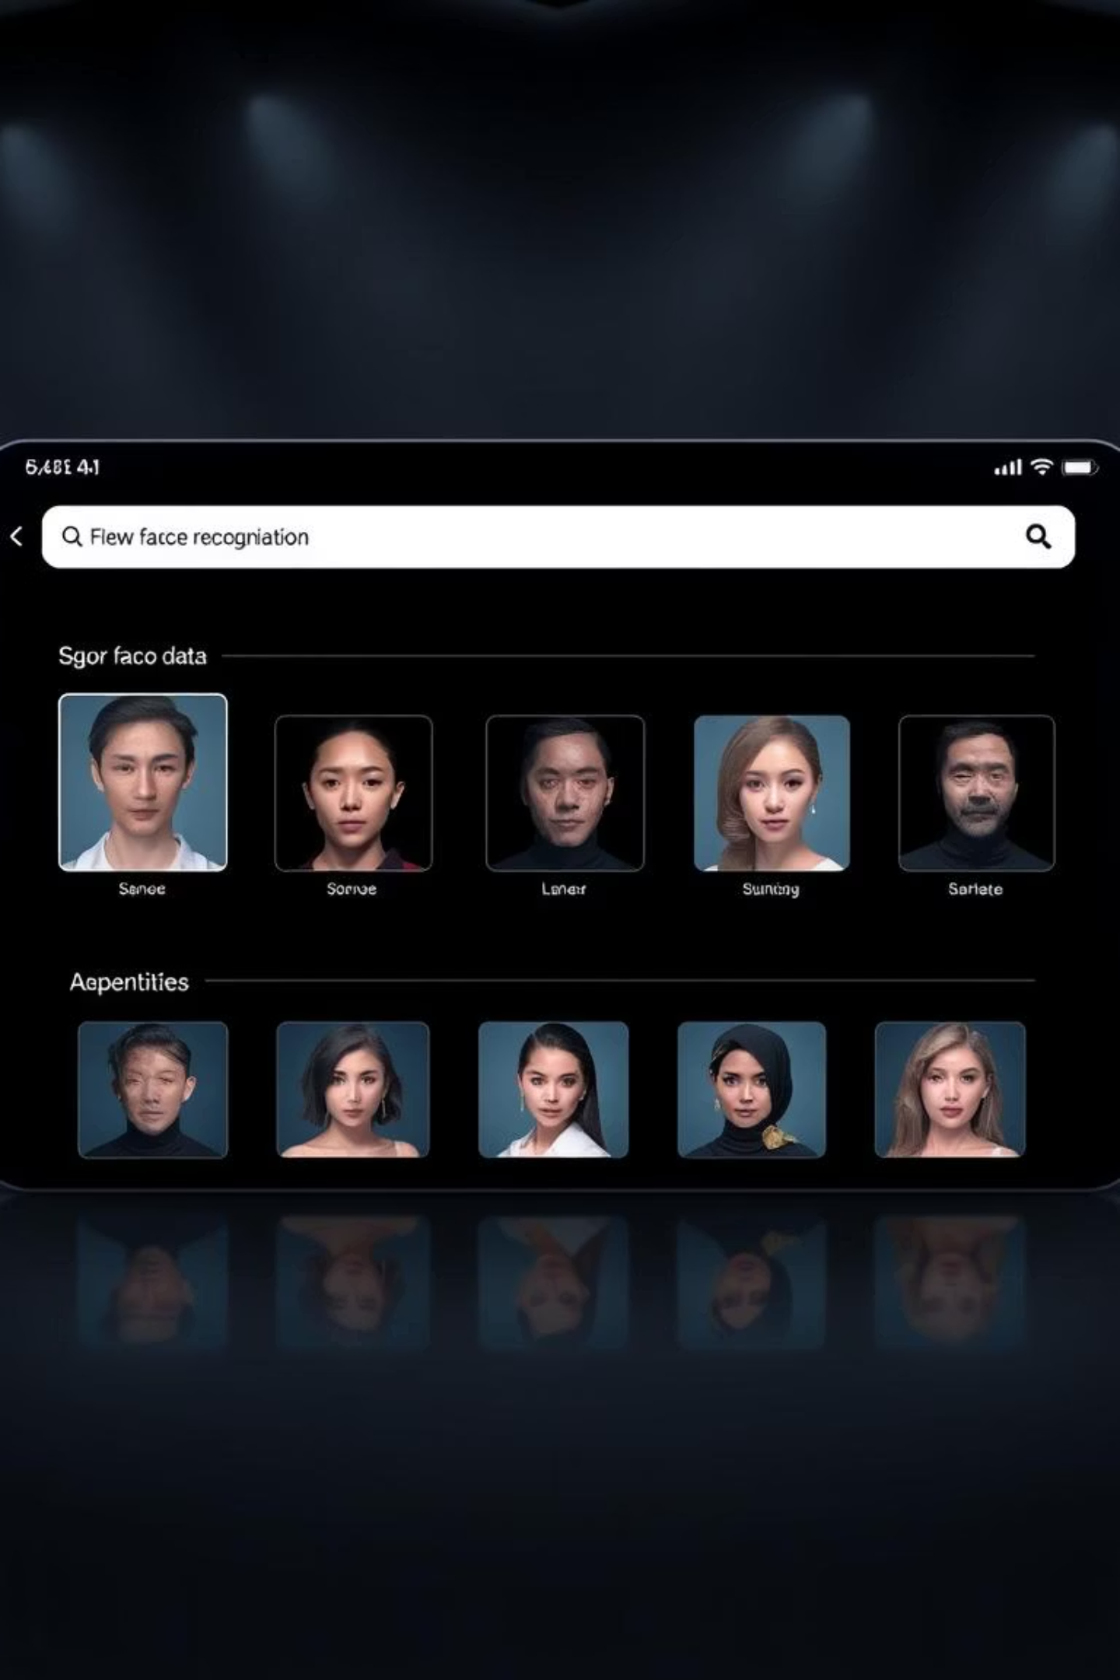
Find Me: A Web Application for Cross-Image Identification
This presentation outlines the development of "Find Me," a web application designed to identify individuals across a collection of images using advanced face recognition technology.

Slide 2
Problem Statement: Efficient Image Search
The core problem "Find Me" addresses is the tedious and time-consuming process of manually sifting through numerous images to locate a specific person. Our solution aims to automate this, providing a precise and rapid search capability.
Given an input image of a person, search through a set of images and find all instances where that person appears. Develop a web application that takes a person’s image as input and returns all matching images as output.

Slide 3
Functional Requirements: Core Capabilities
Image Input & Processing
Intelligent Image Filtering
The system must accept a target image, crop, detect, and encode the face for identification. It also supports batch uploads of search images and validates image formats.
Only images containing human faces will be processed; others are discarded to optimise search performance and relevancy. This ensures efficient use of computational resources.
Search & Output
User Control
The application will initiate a comprehensive search, compare faces, and display all matching images. If no matches are found, a clear "no results" message will be provided.
Users have the ability to clear all uploaded images, facilitating new search queries without requiring a page refresh or application restart.

Slide 4
Non-Functional Requirements: Quality Attributes
Performance
Security
Instantaneous image upload and swift display of results, ensuring a seamless user experience.
Secure processing of all uploaded images to protect user data and privacy.
Optimised algorithms for rapid face encoding and comparison.
Immediate deletion of images from the server upon processing completion or user request.
Usability
Reliability
Clean, interactive user interface with clearly labelled fields for intuitive navigation.
Robust error handling mechanisms to provide meaningful feedback to users in case of issues.
Inclusion of a progress bar to provide real-time feedback during processing.
System resilience to ensure consistent operation.
Responsive design for optimal viewing across various devices and screen sizes.
Compatibility
Frontend designed for compatibility with major web browsers, including Chrome, Firefox, Edge, and Safari.

Slide 5



Technology Stack: Foundation of Find Me
Frontend Development
Backend Infrastructure
Hosting & Database
Leveraging JavaScript with the React framework for a dynamic UI, styled using Tailwind CSS. Axios will manage HTTP requests, ensuring efficient data exchange.
Python powers the backend, utilising FastAPI for robust API development, served via Uvicorn. Key libraries include face_recognition, python-multipart, and Pillow for image processing.
Vercel is chosen for hosting, providing a scalable and performant environment. PostgreSQL, a SQL-based system, is available for optional database requirements, ensuring data persistence and integrity.

Slide 6
Project Planning: Development Roadmap
Project Initialisation
Establish a Git repository for version control, ensuring collaborative development and robust code management from the outset.
Frontend Design & Development
Design and implement the React-based user interface, focusing on intuitive UX/UI elements that enhance user interaction and visual appeal.
Backend API Creation
Develop the FastAPI backend, implementing core face recognition logic using Python's face_recognition library for image loading, comparison, and output generation.
Integration & Refinement
Connect the frontend and backend components, then refine the application for optimal performance, responsiveness, and user-friendliness.
Testing & Deployment
Thoroughly test the application across various browsers and deploy it to the Vercel hosting platform, ensuring broad accessibility.
Ongoing Maintenance
Continuously monitor performance, gather user feedback, and implement necessary updates to ensure long-term stability and user satisfaction.

Slide 7

Expected Outcomes: Transforming Image Search
Upon completion, "Find Me" will deliver a highly efficient and accurate facial recognition web application. It will significantly reduce the time and effort required to locate individuals within large image datasets, enhancing productivity for both personal and professional use cases.

Slide 8

Thank You

